Slide 1
Choosing statistical methods
Class intro

Slide 2
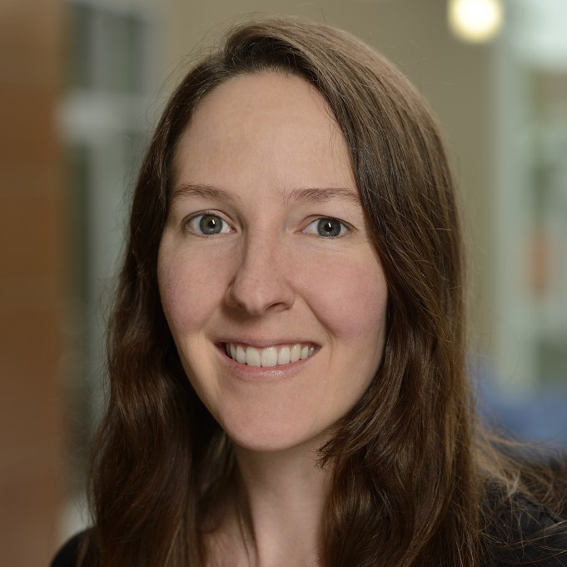
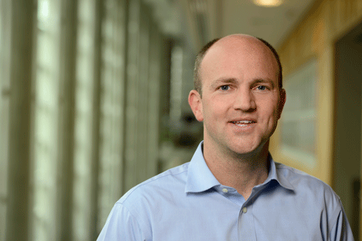
About
Alexis Battle: population genetics, “junk DNA”
Patrick Cahan: stem cell genomics

Slide 3
You will choose statistical methods
... whether you want to or not!
Public health & medicine
Molecular and cell biology
Astronomy & physics
Economics & political science
Meteorology & climate science
Many fields of engineering
Fraud detection
…

Slide 4
Objectives
- Recognize common tradeoffs in statistics
- Demonstrate results via computer simulation

Slide 5


What we will do
Programming (lesson 1) and the binomial distribution (lesson 2): fundamental tools to help design simulation studies

Slide 6
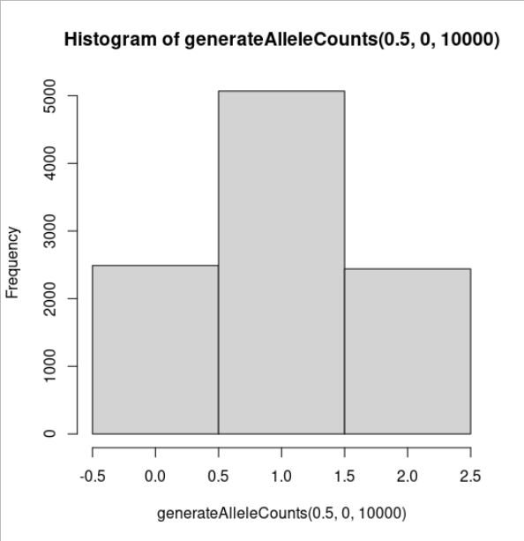
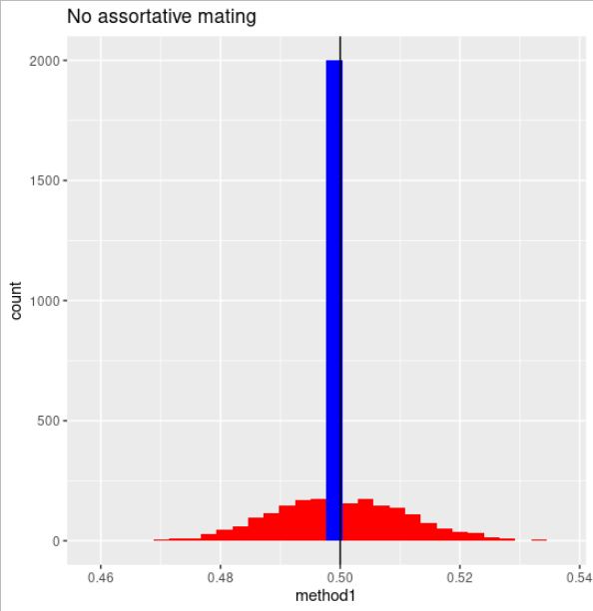
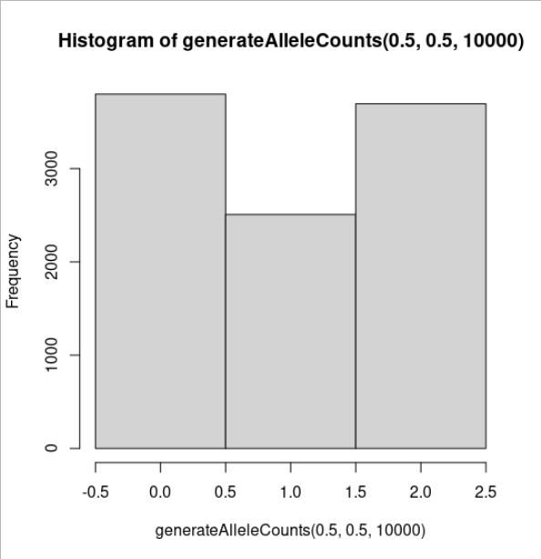
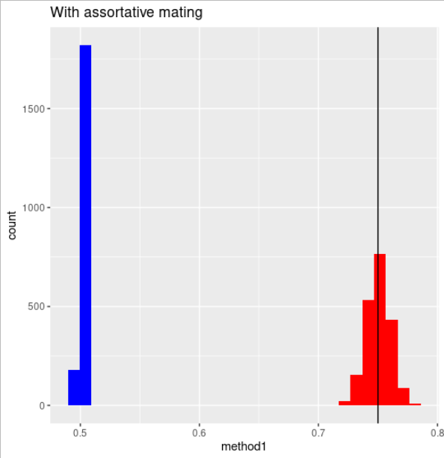
What we will do
Efficiency (lesson 3) and robustness against mistaken assumptions (lesson 4).

Slide 7
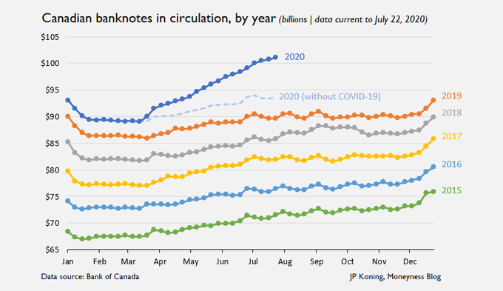
What we will do
Outliers (lesson 5)

Slide 8
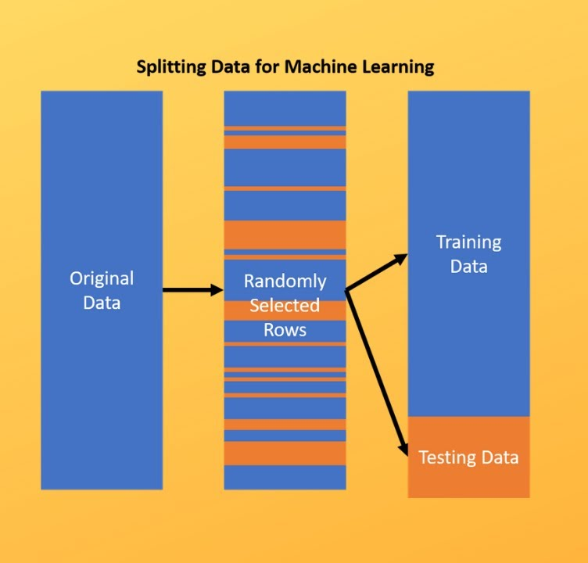
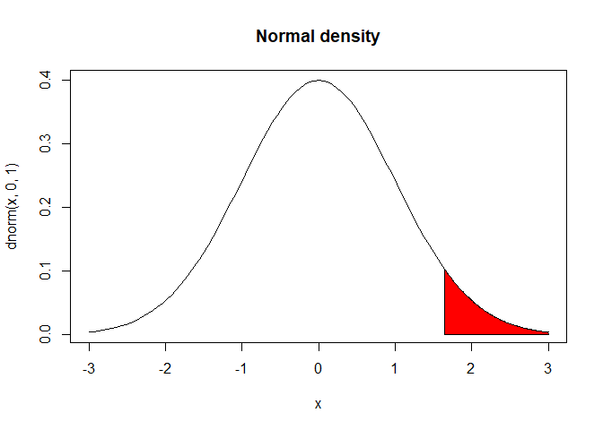
What we will do
Y = b₀ + b₁X₁ + b₂X₂ + b₃X₃
X and Y are given; b is unknown
Prediction versus false positive control (lesson 6)

Slide 9

I hope you can:
Get stuff done
Take a bird’s-eye view
Image from the Baltimore Sun darkroom: Inner Harbor during the 1973 City Fair.
https://darkroom.baltimoresun.com/2016/10/a-birds-eye-view-of-baltimore-in-1973/#1

Slide 10
How the class works
- We only meet 10 times (750 minutes total).
- You need a computer that can access the internet.
- Course website: https://github.com/ekernf01/HEART_choosing_stat_methods
- All admin info is in the syllabus.
- Expectations:
- Please do not come to class if you have respiratory symptoms.
- Otherwise, please come to class in person.
- Before each class, turn in what you are currently working on and describe your progress or difficulties. This is required whether you are in class or not.
- Class is via Zoom next week!

